Slide 1


Analysis of RNA-seq data
Day 3 recap

Slide 2
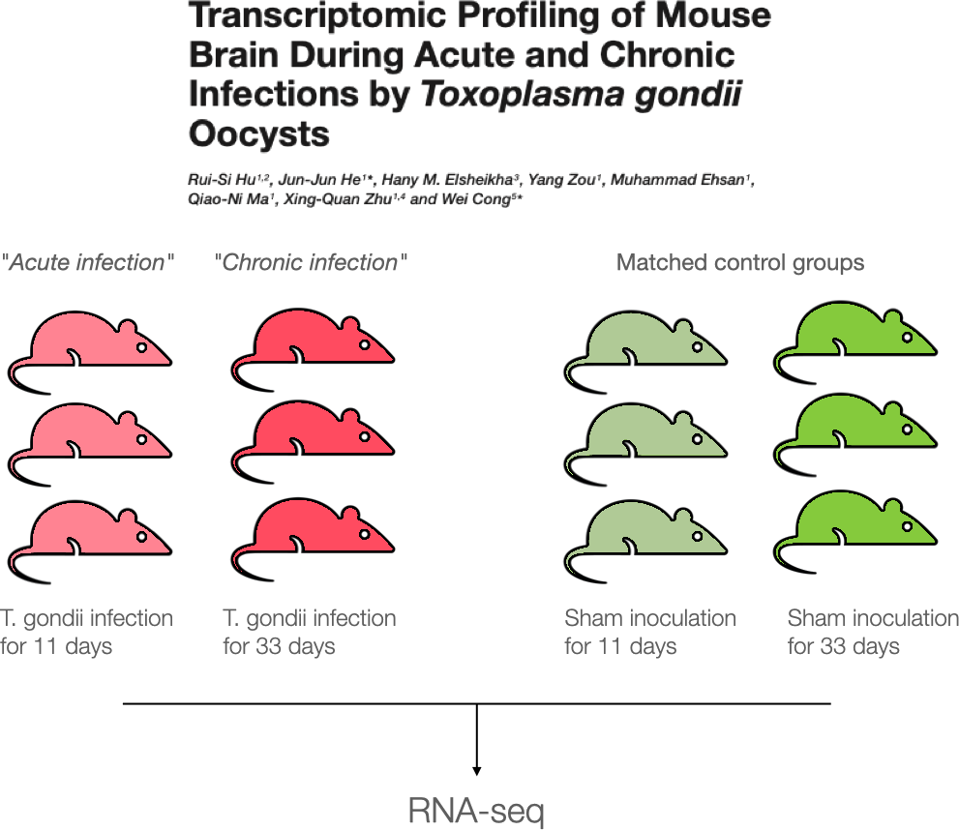
Case Study

Slide 3
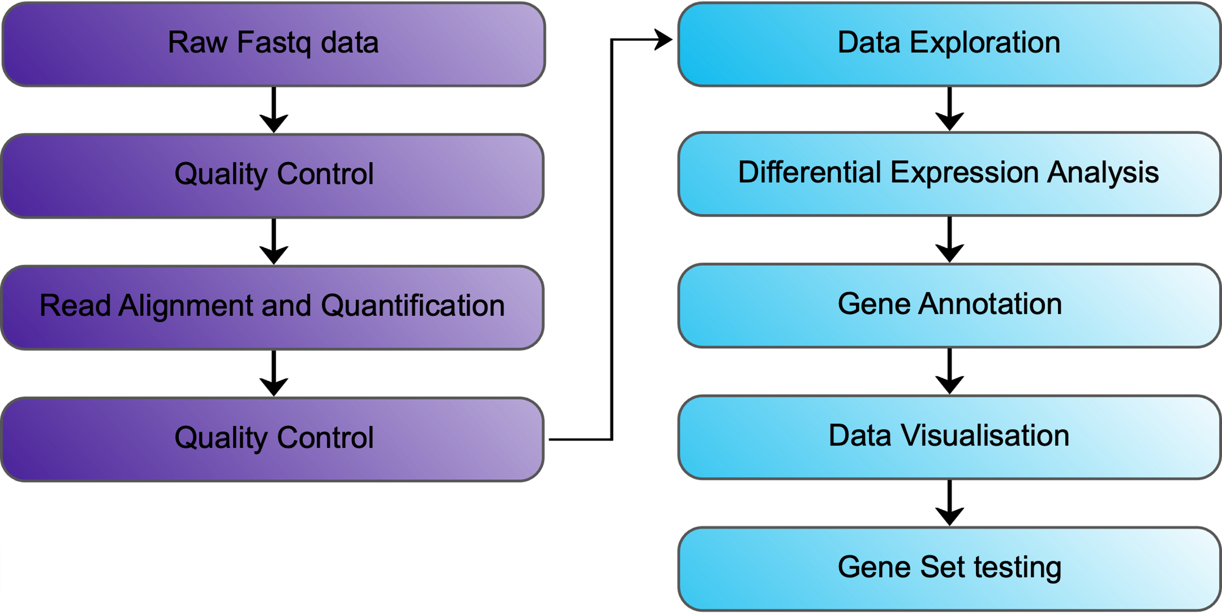
Bioinformatics Analysis Workflow

Slide 4
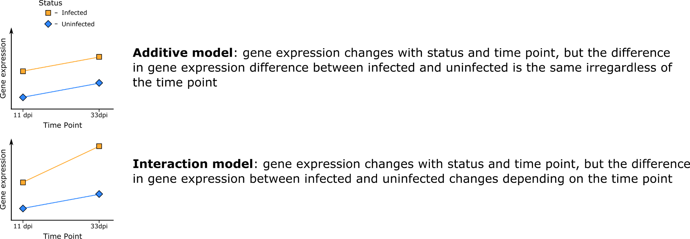
Two Factor Models

Slide 5
DESeq2 | Models and Hypothesis Testing | Two-Factor Additive Model
Formula syntax:
~ Status + TimePoint
DESeq coefficient names:
𝛽₀ → Intercept
𝛽₁ → Status_Infected_vs_Uninfected
𝛽₂ → TimePoint_d33_vs_d11
Null hypothesis:
Infected vs Uninfected
𝛽₁ = 0
d33 vs d11
𝛽₂ = 0
𝛽₁
𝛽₁
𝛽₂
𝛽₂
𝛽₀
Un
d11
In
d11
Un
d33
In
d33

Slide 6
DESeq2 | Models and Hypothesis Testing | Two-Factor Interaction Model
Formula syntax:
~ Status + TimePoint + Status:TimePoint
~ Status * TimePoint
Null hypothesis:
Infected vs Uninfected (d11)
𝛽₁ = 0
Infected vs Uninfected (d33)
𝛽₁ + 𝛽₃ = 0
d33 vs d11 (Uninfected)
𝛽₂ = 0
d33 vs d11 (Infected)
𝛽₂ + 𝛽₃ = 0
Interaction (“Difference of differences”)
𝛽₃ = 0
𝛽₃
𝛽₁
𝛽₁
𝛽₂
𝛽₂
𝛽₀
Un
d11
In
d11
Un
d33
In
d33

Slide 7
DESeq2 | Models and Hypothesis Testing
Considered Experimental Design
Check your analysis through its process
Select the simplest appropriate model for your data which best describes the majority of genes
Know when to visit a bioinformatician or statistician.

